Slide 1
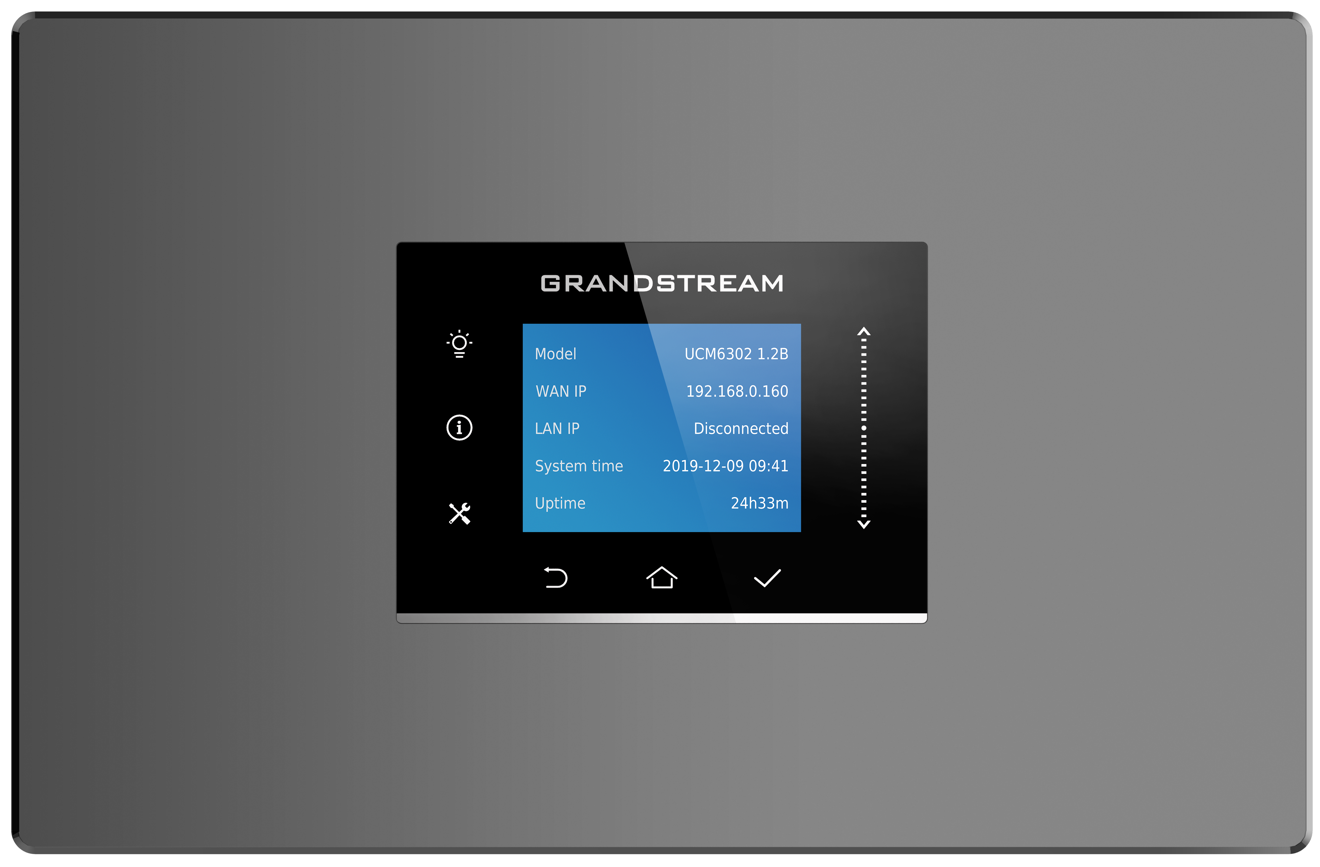
UCM6300 Series IP PBXs
The UCM6300 series of IP PBXs allows businesses of all sizes to build powerful and scalable unified communication solutions in an easy-to-manage fashion with no licensing fees. This enterprise-grade IP PBX supports up to 5000 users and allows businesses to unify all their communication technologies on to one centralized network. The UCM6300 series can be integrated with third-party applications and platforms, including customer relationship management (CRM) and property management systems (PMS), and offers an API for additional custom integrations. By offering thousands of secure and reliable features at an all-inclusive price point without any licensing fees, costs-per-feature, or recurring fees, the UCM6300 series allows enterprises, offices, hotels, retail chains, call centers and more to create a seamless unified communication solution.
Competitive Features:
Supports up to 5000 users and up to 400 concurrent calls
Zero configuration provisioning of Grandstream SIP endpoints
API available for third-party integrations, including CRM and PMS platforms
Compatible with GDMS for cloud setup, management and monitoring
 | UCM6301 | UCM6302 | UCM6304 | UCM6308
LCD Display | 320x240 LCD with touch screen for shortcut keys and scroll bar
Users | 50 | 1000 | 2000 | 5000
Concurrent Calls | 15 | 200 | 300 | 400
Video Conferencing | none | Up to 20 | Up to 30 | Up to 40
Voice Conferencing | Up to 15 | Up to 80 | Up to 120 | Up to 160
FXS Ports | 1 RJ11 Port | 2 RJ11 Ports | 4 RJ11 Ports | 8 RJ11 Ports
FXO Ports | 1 RJ11 Port | 2 RJ11 Ports | 4 RJ11 Ports | 8 RJ11 Ports
API | Full API available for third-party platform and application integration
Call Center | Multiple configurable call queues, automatic call distribution (ACD) based on agent skills/availability/work-load, in-queue announcement
Operating System | Based on Asterisk version 16
Reset Switch | Yes, long press for factory reset and short press for reboot
5-level IVR and multi-language auto-attendant
Three Gigabit auto-sensing RJ45 network ports with integrated PoE/PoE+

